Slide 1
the Chickasaw Nation
Division of Health
Department of Epidemiology, Research
and Public Health
Sheryl Goodson
Michael Peercy
Bobby Saunkeah
Susan Alexander
Kent Denson, MD

Slide 2
Chickasaw Nation Division of Health
Department of Epidemiology, Research and Public Health
Objectives:
Understand the roles of tribal research programs in Indian Country.
Identify strategies for changing the traditional research model/paradigm.
Identify benefits and challenges for establishing a tribal-based, public health focused research program.

Slide 3
Mission of the CNDH
Chickasaw Nation Division of Health
Department of Epidemiology, Research and Public Health
To provide American Indians with health services that promote healing and wellness.
Department mission:
Promote research that enriches the lives of our people and diminishes the disparate burden of disease.
Protect the safety of our research participants and guard the integrity and heritage of the Chickasaw Nation.

Slide 4
Vision of the CNDH
Chickasaw Nation Division of Health
Department of Epidemiology, Research and Public Health
Healthy American Indians through informed
choices and excellent health services.
Department vision:
Transparent research beneficial to our community that enhances the wellbeing of the whole tribe.
Data storage and management that maximize educated health decisions by access to current, reliable data.

Slide 5
Research Potential - CNDH
Chickasaw Nation Division of Health
Department of Epidemiology, Research and Public Health
Chickasaw Nation Medical Center: emerging contributor in biomedical research involving American Indians.
Infrastructure to manage influx of research partnerships:
University of Oklahoma Health Sciences Center
Harold Hamm Diabetes Center
General Clinical Research Center
OU Cancer Institute
Oklahoma Medical Research Foundation

Slide 6
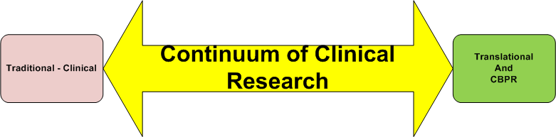
Continuum of Research:
Chickasaw Nation Division of Health
Department of Epidemiology, Research and Public Health
CNDH currently participates in studies that cover a broad range of topics and research approaches.
Dr. Lyons’ Pre-eclampsia studies: “Pure Research” – Benefit for the good of all Native Americans – Reduction of health disparities.
Dr. James’ Rheumatology study: Direct clinical services to the tribe in exchange for research participation.
Chickasaw Nation Nutrition Services: Research initiated by the community (CBPR).

Slide 7
Department Roles:
Chickasaw Nation Division of Health
Department of Epidemiology, Research and Public Health
Research opportunity and development
Research intake and navigation
Coordination of research efforts
Dissemination of research findings
Epidemiology and biostatistics
National reporting
Human research protection program
Bio-medical grant management

Slide 8
Research Benefits: Partnerships
Chickasaw Nation Division of Health
Department of Epidemiology, Research and Public Health
Access to specialty clinical services :
Rheumatology - (Judith James, MD, PhD; OMRF)
Pediatric diabetes treatment and education (Kenneth Copeland, MD; OUHSC)
Creation of opportunities for citizens and employees:
NARCH summer undergraduate research program
NARCH faculty development program

Slide 9
Research Benefits: Partnerships
Chickasaw Nation Division of Health
Department of Epidemiology, Research and Public Health
NIH grant (in partnership with OUHSC ) to create a Translational Diabetes Research Center at CNMC
Provide the latest in diabetes treatment options
Requires support of an internal research infrastructure.

Slide 10
Research Benefits: Partnerships
Chickasaw Nation Division of Health
Department of Health Research and Statistics
the Chickasaw Nation partnership with the
OUHSC Cancer Institute:
Improved access and utilization of services
Native American patient navigator
State-of-the-art cancer clinical trials
Immediate initiation of therapy
Research

Slide 11
Research Benefits: CNDH Generated
Chickasaw Nation Division of Health
Department of Epidemiology, Research and Public Health
Improved services
WIC program – “Tapping into the Power of Influence” research study:
20% increase in breastfeeding initiation .
16% increase in client enjoyment with WIC visit.
10% increase in client comfort with WIC visit.
80% increase in WIC employee job satisfaction .

Slide 12
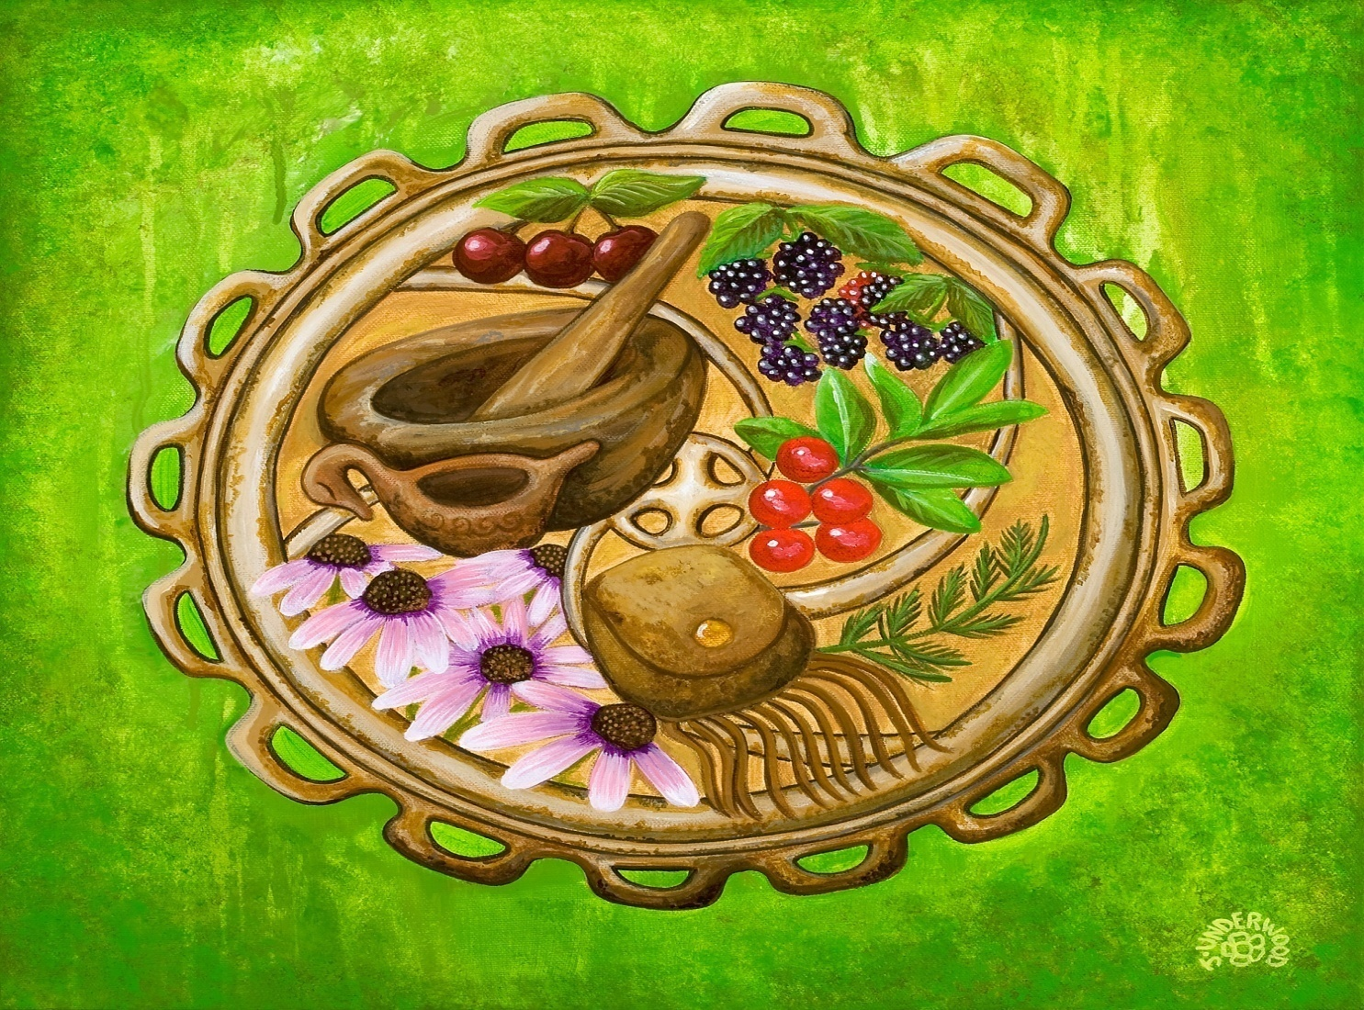
Pathways to Wellness: Native American Research Partnerships conference (hosted by the Chickasaw Nation)

Slide 13
Epidemiology/Clinical Data Management and Reporting
Chickasaw Nation Division of Health
Department of Epidemiology, Research and Public Health
Epidemiology:
Provides CNDH Administration with valid clinical data to support planning and development
Promotes internal research by providing hypothesis generating reports
Surveillance of disease throughout the Chickasaw Nation
Data Management:
Storehouse for all clinical reporting in the CNDH
Invaluable resource for planning and grant application

Slide 14
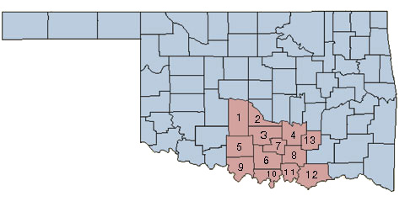
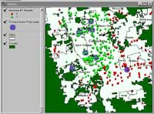
Chickasaw Nation Division of Health
Department of Epidemiology, Research and Public Health
Work with the Division of Housing to utilize existing GIS technology
Uses:
Disease Tracking and Surveillance
Disease cluster analysis (e.g. Cancer, Diabetes)
Infectious disease tracking (e.g. influenza)
Facility specific health measures at a glance
Geographic evaluation of Chickasaw communities for new services
Evaluate prospective sites for new facilities

Slide 15
Bio-Medical Grant Management
Chickasaw Nation Division of Health
Department of Epidemiology, Research and Public Health
Proactive grant search and investigation.
Grant writing (Biomedical grants are very different than other grants, and require a scientific plan for justification)
Pre-Award and Post Award administrative support
Budgeting and financial support
Scope of work compliance and progress report writing
Continuing application
Rewriting and resubmission of non-funded grants
Notes:
CNDH currently receives $1,683,000 in grants.
A quick search of grants.gov showed multiple grants with total funding in excess of $60,000,000
Potential Government Grant Sources:
National Institutes for Health (NIH)
Centers for Disease Control and Prevention (CDC)
Indian Health Service (IHS)
Health Resource Services Administration (HRSA)
Substance Abuse and Mental Health Services Administration (SAMHSA)
Private Funding Institutions
Robert Wood Johnson Foundation
Susan G. Komen Foundation

Slide 16
Human Research Protection Program
Chickasaw Nation Division of Health
Department of Epidemiology, Research and Public Health
CNDH Institutional Review Board:
Protects safety and confidentiality of human research subjects
Is guided by the Office of Human Research Protections (OHRP)
Requires administrative support to manage increasing volume of protocols
Promotes inter-divisional collaboration to ensure protection of subjects throughout CN
Certification/training

Slide 17
Phased Implementation
Chickasaw Nation Division of Health
Department of Epidemiology, Research and Public Health
Year one:
Planning
Organization
Training
Strengthening Research Partnerships
Develop Community Advisory Board
Epidemiological reporting and surveillance
Automation of IRB processes
Grant Investigation
Year two:
Implementation of IRB automation
Matching of CNDH issues with available grants
Full project management of protocols
Initiating research from the community (CBPR)

Slide 19
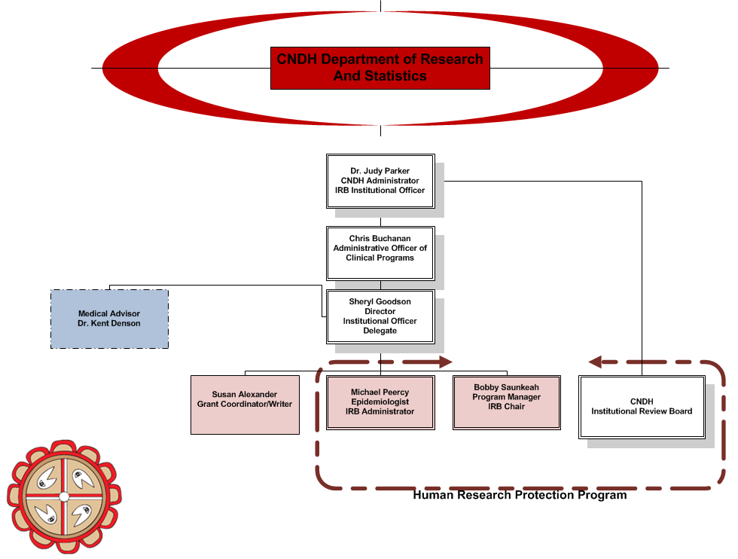
Chickasaw Nation Division of Health
Department of Epidemiology, Research and Public Health

Slide 20
Challenges
Chickasaw Nation Division of Health
Department of Epidemiology, Research and Public Health
Office space
Misconception of department roles
Significant amount of time spent on grant activities
Other duties as assigned
Slow development process with little visible product
Conflicts of interest
Academic “mind-set” vs. programmatic/utilization “mind-set”

Slide 21
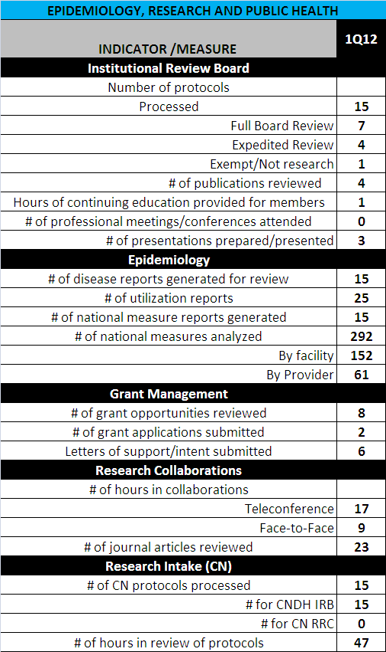

Slide 22
progress
Chickasaw Nation Division of Health
Department of Epidemiology, Research and Public Health
CNDH/OU Norman collaboration aims:
Research partnership – data
CNDH:
Data sharing
Community research
Cultural and clinical expertise
University of Oklahoma:
Computing
Technical assistance
Research collaboration

Slide 23
progress
Chickasaw Nation Division of Health
Department of Epidemiology, Research and Public Health
CNDH/OU Norman collaboration aims:
Establish the infrastructure necessary to support a long-term health research program
Develop a repository for health information to support research, administrative, and clinical applications
Develop longitudinal population health histories to establish a basis for chronic disease prevention, surveillance, and service models for a target population

Slide 24
progress
Chickasaw Nation Division of Health
Department of Epidemiology, Research and Public Health
CNDH/OU Norman collaboration aims:
Memorandum of Understanding
Business Associate’s Agreement
Research Advisory Council (CNDH and OU)
Research protections
CNDH IRB named “IRB of record” for all projects related to this endeavor

Slide 25
progress
Chickasaw Nation Division of Health
Department of Epidemiology, Research and Public Health
NARCH VII:
Selection of NARCH program co-coordinators
Strong academic partner advocates
Generation of ideas for projects
Selection process for projects
Vitamin D
tissue banking
data base
Diabetes peer educator program
Medical home model

Slide 26
progress
Chickasaw Nation Division of Health
Department of Epidemiology, Research and Public Health
NARCH VII Faculty Development Project:
CBPR training/actual experience for interested tribal personnel
Establish tribal/academic IRB engagement process
Develop model approach for conducting research in tribal communities for use as a training tool in academic settings.

Slide 27
Future
Chickasaw Nation Division of Health
Department of Epidemiology, Research and Public Health
Currently working on 15 grant opportunities for research and public health:
Internal
Collaboration – initiated by the academic center
Collaboration – initiated by CNDH
Current and proposed partners:
OUHSC
Stephenson Cancer Institute
Harold Hamm Oklahoma Diabetes Center
Oklahoma Medical Research Foundation
OU Norman
Department of Geography and Environmental Sustainability
Climate Science Center (National Weather Center)
Center for Applied Social Research
Oklahoma City Area Indian Health Board
University of Massachusetts
Centers for Disease Control and Prevention

Slide 28
Questions??
Chickasaw Nation Division of Health
Department of Epidemiology, Research and Public Health
Thank you!
Sheryl Goodson, CPH, RHIA, CPMSM – Director
Bobby Saunkeah, RN, CDE, CIP – Program Manager – IRB Chair
Michael Peercy, MPH, MT(ASCP)H – Epidemiologist – IRB Administrator
Susan Alexander – Grant Coordinator
Kent Denson, MD – Medical Staff Advisor

